Slide 1

[Samsung PRISM] End Review Report
Best AP selection using AP score prediction
Team
College Professor(s): Dr. KAYARVIZHY N
Students:
Akash V
Ajit J Gupta
Manoj Howale S
Department: AI/Ml, EEE, CSE
Date: 24 June 2023

Slide 2

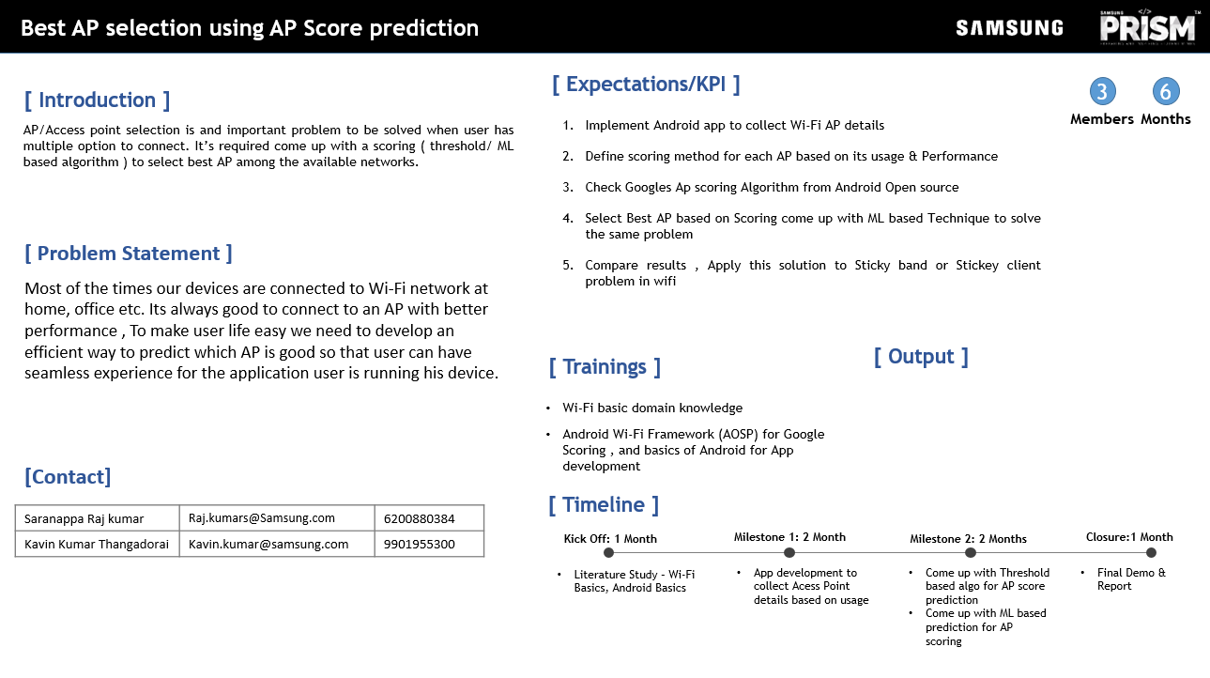
Notes:
-

Slide 3
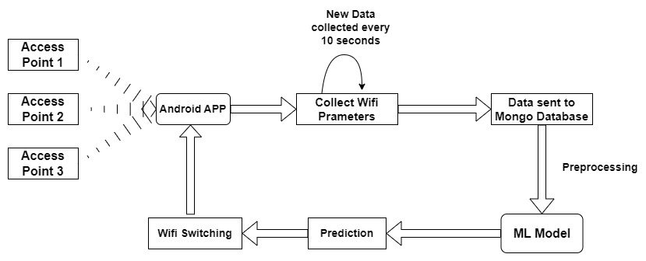
Approach / Solution
Concept Diagram :

Slide 4
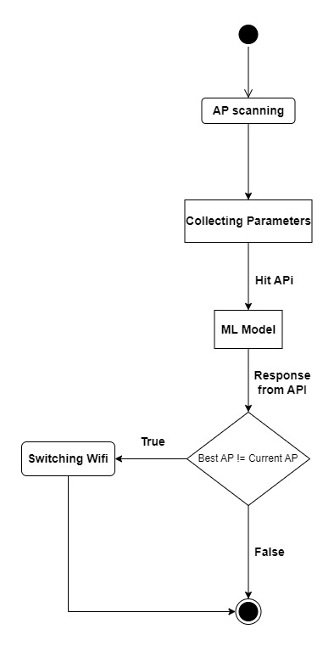

Slide 5
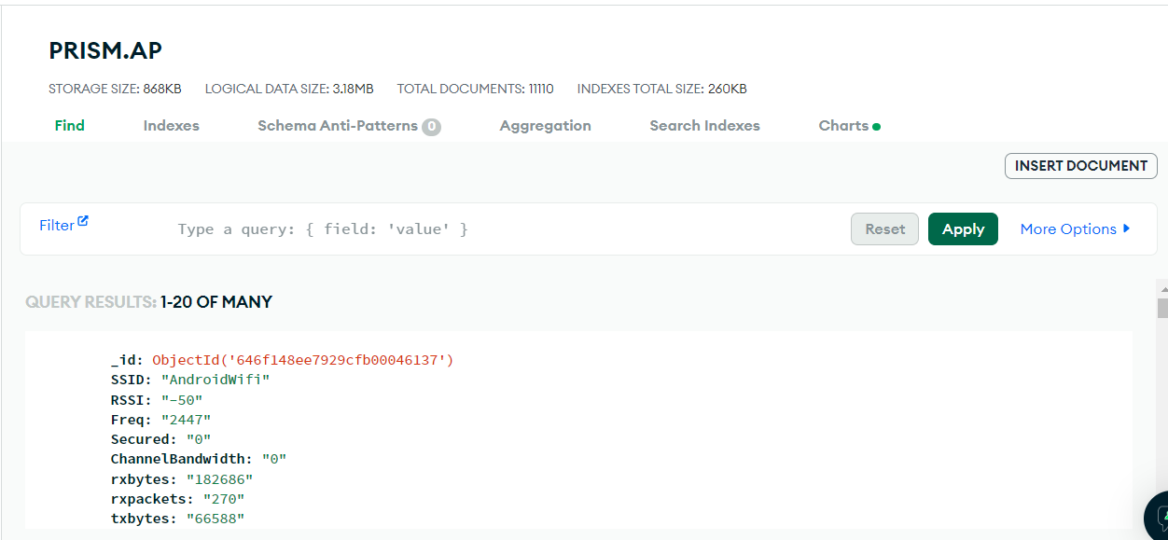
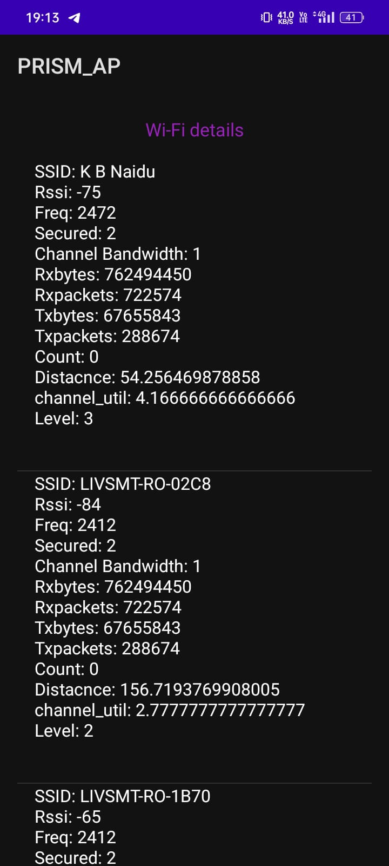
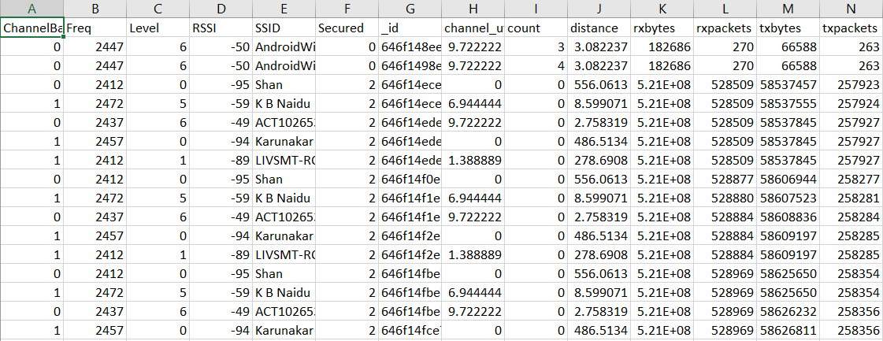
Dataset Collected
Cloud
Local

Slide 6
Dataset(s) Analysis / Description
Dataset Capture / Preparation / Generation :
Real-time dataset was prepared by running the app in the background in the phone, while running day to day applications and actions like downloading and uploading content to obtain variance.
Every ten seconds the receiver refreshes to prevent redundant data entries.
Dataset is send to mongoDB Atlas database.
Dataset Understanding / Analysis :
The major features in the dataset are : RSSI, Frequency ,Channel Bandwidth, Traffic parameters, Previous number of connections, channel utilization and distance from the access point.
Most of the columns are correlated at some point.
Dataset Preprocessing / Related Challenges (if any) :
Removing Null values
Removed duplicates
Removing Outliers

Slide 7
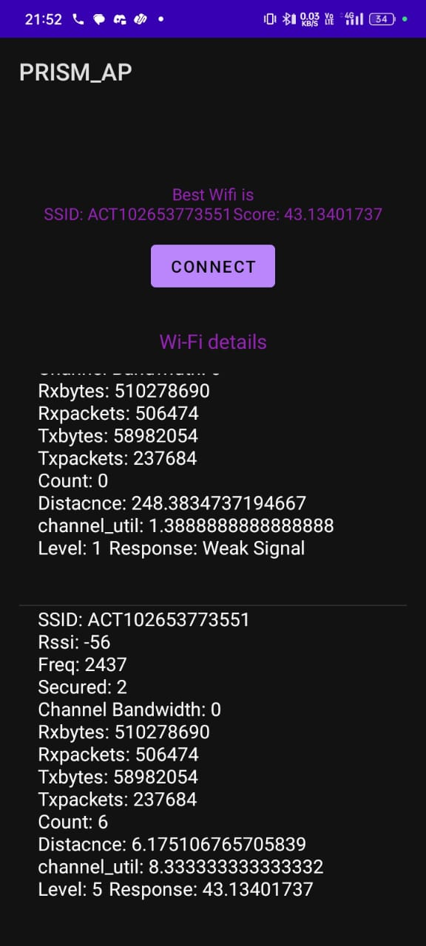
Experimental Results / Simulations / Observations
Screenshot of the APP (collecting dataset) :
Screenshot of the APP (For User) :

Slide 8
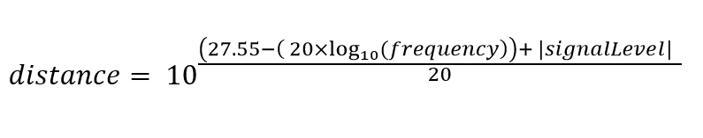

Formulas used
1.
2.
3.
4.
5. SCORE = NScore + trafficScore

Slide 9
Technical challenges faced by team
Google scoring algorithm
Difficulty in finalizing the parameters to be considered as features in the machine learning model.
Collecting real-time dataset was a challenging task, especially to incorporate the variances required to prevent overfitting of the models.
No direct method to get channel utilization from the beacon.

Slide 10
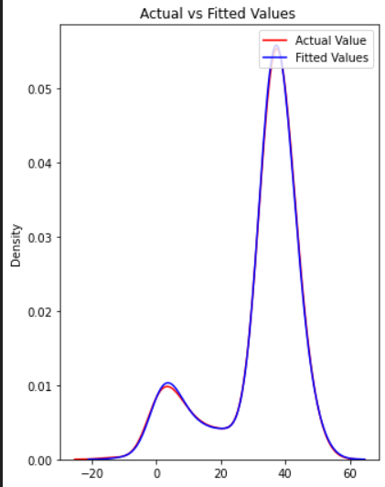
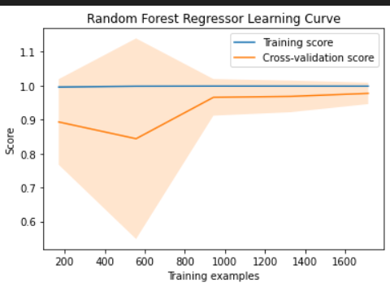
Results
Model Name | Accuracy
Random Forest | 96.01
Decision Tree Regressor | 97.01
LinearRegression(lasso) | 96.48
Actual vs Fit graph (Random Forest)

Slide 11
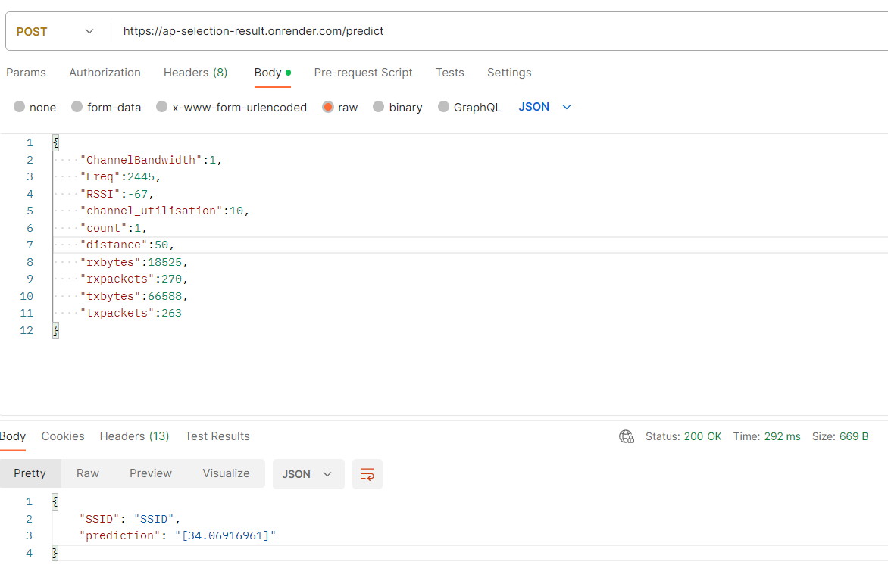
API Call

Slide 12
Deliverable
Final Deliverables :
Android Application
1. For Data Collection
2. User application
APIs
For connecting to MongoDB
For predicting the score
IP / Paper Publication Plan :
https://github.ecodesamsung.com/SRIB-PRISM/BMSCE_NCG06BMS_Best_AP_selection_using_AP_Score_prediction/blob/main/PrismPaper.docx
KPIs delivered/Expectations Met:
Implemented Android app to collect wifi details.
Defined Scoring algorithm for each AP based on usage and performance.
Referred to Google’s AP scoring algorithm for understanding which parameters to collect.
Successfully made ML based models (linear regression, decision trees and random forest).
If automatic switching enable sticky client problem can be solved

Slide 13
Work-let Closure Details
Code Upload details:
Items | Details
KLOC (Number OF Lines of codes in 000’s) | 1592
Model and Algorithm details | Machine Learning Model - Linear Regression, Decision tree, Random Forest Android Application
Is Mid review, end review report uploaded on Git ? | Yes
Link for Git | https://github.ecodesamsung.com/SRIB-PRISM/BMSCE_NCG06BMS_Best_AP_selection_using_AP_Score_prediction
Data details (if applicable):
Items | Data folder 1
Name & Type of Data | AP_details (csv)
Number of data points | 10731
Source of Data (self collected, Scrapped, available on open source) | Self Collected
git link to access data | https://github.ecodesamsung.com/SRIB-PRISM/BMSCE_NCG06BMS_Best_AP_selection_using_AP_Score_prediction/blob/main/Models/AP_details.csv

Slide 14
Thank you

